Slide 1

Transcultural Assessment
Erica Linn
University of St. Francis

Slide 2
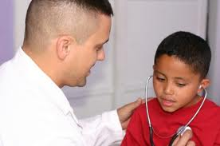
What is Cultural Competence?
“…the process that occurs when culture care values, expressions, or patterns are known and used appropriately and meaningfully by the nurse with individuals or groups” (Castro & Ruiz, 2009, p.279)

Slide 3
Definitions
Culture - “the values, beliefs, norms, and practices of a particular group that are learned and shared and that guide thinking, decisions, and actions in a patterned way’ (Giger, 2013, p.2).
Race – people who “share distinguishing physical features, such as skin color, bone structure, or blood group” (Giger, 2013, p.60).
Ethnicity – “groups whose members share a common social and cultural heritage passed on to each successive generation” (p.60).

Slide 4
Why do we need Cultural Competence?
Our ultimate goal is to find effective ways to teach competency to medical professionals so that both explicit and implicit bias will be reduced, along with the undesirable effects of stereotypes. Such training will allow medical professionals to attain their goal: to help and serve all people through the unbiased provision of health care. (Moskowitz, Stone, and Childs, 2012, p.1000)

Slide 5
Why do we need Cultural Competence?
Another answer:
Luca, Lakey, Arnetz & Arnetz (2010) state,
  Cultural competency has gained momentum as the possible role of cultural factors in healthcare is increasingly emphasized…and has been used to denote the collected efforts of healthcare professionals to provide quality care to patients regardless of race, ethnicity, culture, and language….Currently, beliefs about culturally competent care inform both the standard and practice of healthcare in many nations. (p.452).

Slide 6
The Interview
Rose, 29 year old female, born in the United States
African-American mother, Mexican-American father, married into Eastern European-American family
Rose’s definition of culture, “It’s everything. It’s who you are. It’s what you come from.”

Slide 7

Communication
Native English speaker
Clear, soft, confident voice
Silence, “when it’s comfortable.”

Slide 8
Communication, cont’d
She observes the she naturally slips into an African-American dialect when with African-Americans; Giger (2013) asserts,
  …it is not uncommon for some African-Americans to speak Standard English when serving in a professional capacity or when socializing with Whites and then revert to Black English when interacting in all African-American settings….It is estimated that approximately 80% of African-Americans use Black English at least some of the time. (p.166)

Slide 9
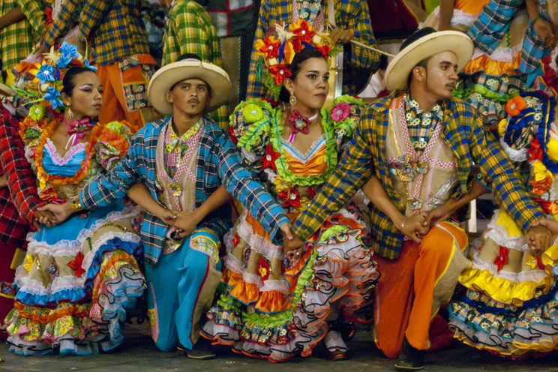
Space
“Probably the same as yours. They say an arm’s length for a personal conversation if you’re friendly.”
“…. But when we’re at home, family, they’re all right next to each other. They get real comfortable.”

Slide 10

Time
when asked whether she sees herself as past-, present-, or future-oriented, Rose comments, “I can be all of those. I like to enjoy today, but you have to work hard to get what you want in the future.”
Usually wears a watch
Tried to be 15 minutes early
reminds family members to take their medications on time

Slide 11
Social Organization
Has seven siblings
Has visitors at their home almost every day, mostly relatives
Many childhood stories include relatives
When asked about her role in her family structure, she comments, “I take care of people, but we’re all close.”

Slide 12
Religion & spirituality
Rose is now Lutheran
Raised Catholic & Baptist
Campinha-Bacote (2009) comments, “African Americans consider themselves spiritual beings, and God is thought to be the supreme healer” (p.51).
Rose expresses agreement with this view.

Slide 13
Environmental Control
Rose defines health as “mind and spirit and physical. Being able to live your life.’” She defines illness as “not caring, not paying attention, not being proactive.” Rose states, “I try to get exercise. I started the wellness program here for employees. I want to get in better shape.”
Rose says that her hobbies help her relax; she gardens, and cooks frequently, often with her sisters and their families.

Slide 14
Cultural Health Practices
This led to a discussion of self-efficacy. Rose states, “You’ve got to work for what you want. You can change your life if you work for it.” This contrasts with Giger’s (2023) assessment of Hispanic views: “There is…a fatalistic belief that one is at the mercy of the environment and has little control over what happens” (p.219).
Rose says that her family gets together when someone is sick.

Slide 15
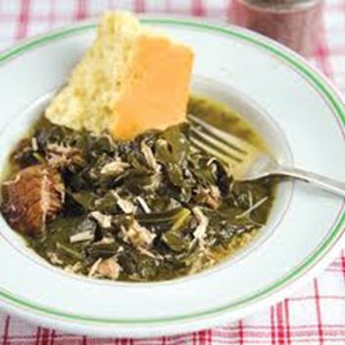
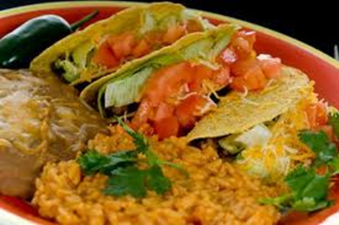
Diet
Rose says, when she was a kid, she says she ate “normal food with some Latin flair, and soul food.” She says, “Oh yeah, we ate greens and all that.”
“I like to eat roots, vegetables that are of the earth. I love beets and rutabaga.”

Slide 16
Biological Variations
Rose is 5’6”, borderline overweight.
Medium caramel skin
Thick, curly, chin length hair
Reports good health; seasonal allergies are her only problem
Family has, “The usual stuff. Hypertension, diabetes. My grandma had stomach cancer.”
Giger (2013) reports, “African-Americans have the poorest rate of hypertension control” (p.185) and “[t]he prevalence of type 2 diabetes is higher in African-Americans than in Whites (p.187).

Slide 17
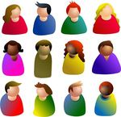
Nursing Assessment
Rose acknowledges that she is a mix of African-American culture, Hispanic culture, and White culture. She says, “I can be comfortable in a lot of different situations.”

Slide 18

Nursing Diagnoses
Altered nutrition: potential for more than body requirements
Health seeking behaviors (specify) or desire for high-level wellness (specify)
Family coping: potential for growth (NANDA nursing diagnosis list, 2012).

Slide 19

Plan of Care
Encourage health seeking behaviors, including exercise, healthy diet, and weight loss
Encourage family coping patterns
Encourage continued integration of cultural practices, to maximize functioning within each environment

Slide 20


Conclusions
Rose’s cultural experience provides examples of specific cultural features; this specific knowledge is essential to developing cultural competence. With this knowledge, the culturally sensitive health care provider can take the next step: examination of how to develop cultural competence.

Slide 21
References
Campinha-Bacote, J. (2009). A culturally competent model of care for African Americans. Urologic Nursing, 29 (1), 49-54.
Castro, A. & Ruiz, E. (2009). The effects of nurse practitioner cultural competence on Latina patient satisfaction. Journal of the American Academy of Nurse Practitioners, 21, 278-286.
Giger, J. (2013). Transcultural nursing assessment and intervention. (6th ed.). St. Louis, MO: Elsevier Mosby.
Lucas, T., Lakey, B., Arnetz, J., & Arnetz, B. (2010). Do ratings of African-American cultural competency reflect characteristics of providers or perceivers? Initial demonstration of a generalizability theory approach. Psychology, Health & Medicine, 15(4), 445–453.
Moskowitz, G., Stone, J. & Childs, A. (2012). Implicit stereotyping and medical decisions: unconscious stereotype activation in practitioners’ thoughts about African Americans. American Journal of Public Health, 102(5), 996-1001.
NANDA nursing diagnosis list. (2012). Retrieved from http://www.nandanursingdiagnosislist.org.

