Slide 1
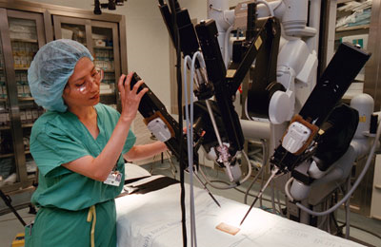
Evidence-Based Practice: the Registered Nurse’s Role in Robotics-Assisted Surgery
Erica Linn
University of St. Francis

Slide 2
Why seek evidence on this topic?
Sutton, Link, and Flynn-Makic (2013) observe, that “[m]inimally invasive robotic surgery is rapidly becoming a common practice” (p.448).
The Milwaukee Department of Veterans’ Affairs Medical Center (VAMC) perioperative interim manager states, “We’re going to start having more robotics surgeries” (personal communication, June 3, 2013).

Slide 3
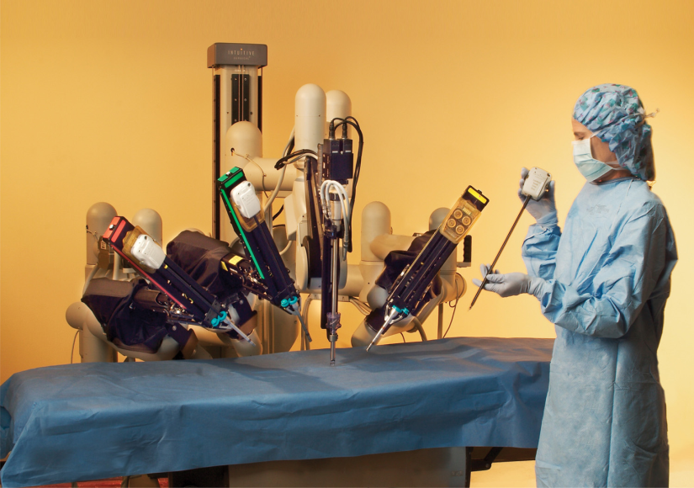
So, the PICOT Question:
In the (P) adult surgical population undergoing robotics-assisted surgery, what (I) safety procedures does the registered nurse need to perform to (O) avoid adverse events in the (T) perioperative period, (C) compared to non-robotics-assisted surgery?

Slide 4
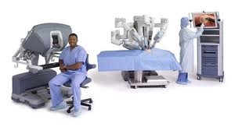
Search Strategy
Databases searched:
  CINAHL
  Cochrane Central Register of Controlled Trials
  Cochrane Database of Systematic Reviews
  Cochrane Methodology Register
  HealthSource
  Medline
  PubMed

Slide 5
Key words
One word was chosen from each group, with the word and as a connector:
  Robotic
  Surgery
  Nurse
  Skills, interventions, practices
  Safe, avoid, adverse, outcomes

Slide 6
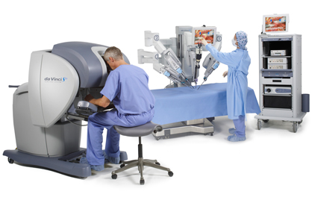
Inclusion Criteria
  English language
  Publication within the past five years
  Focus on the Registered Nurse’s (RN’s) role in robotic-assisted surgery
Nine articles were selected.

Slide 7
Brenner, Z.R., Salathiel, M., Macey, B.A., Krenzer M. (2011 Jul-Aug). Postoperative care for the robotic surgery bowel resection patient.
Level VII Evidence
Findings:
  Authors see need for more evidence on post-operative care.
  Healthcare professionals face a learning curve with equipment.
  Patients may require less opioid medication.
  Shorter inpatients stays necessitate efficient teaching and proactive fluid and electrolyte management for patients with new ostomies.

Slide 8
Murray S. (2009, Winter). Nursing care for patients undergoing transoral robotic surgery.
Level VII Evidence
Findings:
  Authors again call for more evidence.
  Nurses must assess airway and other respiratory indicators, plus pain, speech, and swallowing.
  Oral surgery patients have increased risk for airway edema. Continuous pulse oximetry recommended.
  Nurses must be aware of potentially high surgical complexity, possible internal sutures, and delicate tissue - despite no visible incision.
  Nurses should receive education on robotics methods and rationales for care.

Slide 9
Pittman, G. (2013, March). Robotic surgery tied to temporary nerve injuries.
Level IV Evidence
Design: Descriptive, retrospective study
Sample: 334 robot-assisted urology procedures
Data collection method: chart review
6-7% of patients had nerve injury after procedures, with varying times to healing.
Findings:
  Intraoperative RN should mange positioning to prevent injury.
  Patients should be educated on risk of nerve injury, and that it's usually transient.

Slide 10
Ramsey. R. (2012, March). Robotic gynecologic surgery: trends and nurse involvement at a regional hospital.
Level VII Evidence
Findings:
  RNs should develop knowledge of equipment, and troubleshooting skills.
  Circulating RN drapes robot, performs specified duties under surgeon's direction.
  The scrub nurse sets up and monitors equipment, including the robot.
  Surgery length and OR turnaround time decreases as the surgical team gains proficiency.
  Patient positioning is a significant issue
  Less post-operative pain is reported.

Slide 11
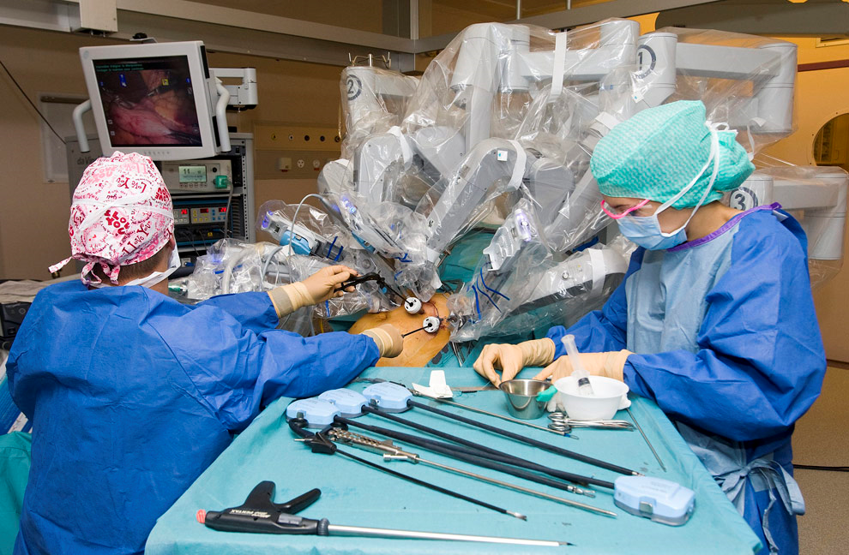
Stanton, C. (2010). Establishing a robotic surgery program.
Level VII Evidence
Findings:
  Patients should have two IVs.
  Nurses should use specialized time-out, and test for secure patient positioning before initiating surgery.

Slide 12
Sutton, S., Link, T., Flynn Manic, M.B. (2103, April). A quality improvement project for safe and effective patient positioning during robot-assisted surgery.
Level VI Evidence
Design: Quasi-experimental with two comparison treatments
Sample: 59 procedures
Data collection method: chart review
Findings:
  No significant difference found in cost, preparation time, skin integrity, or intraoperative movement between positioning with air-inflated positioning device and high-density foam padding.
Conclusion: Foam padding selected due to surgeon preference.

Slide 13
Thell, C.G. (2011, Sep). Patient Advocacy in Robotic Surgery.
Level VII Evidence
Findings:
  Facilities should have a robotic surgery coordinator.
  Nurses should know that patients may face increased anxiety and should receive preoperative robotics education.
  This nurse coordinator/educator should greet the patient on the day of surgery, and follow up after discharge.
  To relieve pre-operative anxiety, the nurse can use standard techniques: calming music, maintain patient modesty, and provide a comforting presence.
  Postoperatively, the nurse should make the patient presentable, provide a warm blanket and a quiet environment, and show a trusting relationship with the recovering nurse.
  A second circulating nurse may help manage complexity.

Slide 14
Thomas, C.C. (2011 Sep). Role of the Perioperative Nurse in Robotic Surgery.
Level VII Evidence
Findings:
  Again, facilities should have a coordinator
  Nurses should become equipment-competent, be willing to train colleagues, and be flexible in scheduling. Surgery times decrease as team gains skill.
  Perioperative care is the same as for any minimally invasive surgery.
  Patients often require less analgesia.
  Shorter stays mean less time for patient education.
  Knowledge demonstration improves patient satisfaction.

Slide 15
Ulmer, B. (2010, May). Best practices for minimally invasive procedures.
Level VII Evidence
Findings:
  Nurse should understand equipment
  Nurses should still practice according to professional standards.
  Most common complications are organ perforation, equipment failures, thermal injuries, and others specific to electro surgery.

Slide 16
State of the Science Summary and Analysis
More evidence is needed.
RNs may apply other minimally invasive surgery skills, but should receive robotics-specific education.
RNs should still practice according to professional standards.
RNs should perform careful, focused physical assessments.
Surgical times and OR turnaround times increase, then decrease as staff gains proficiency.
Robotics-specific risks exist, e.g. organ perforation.
The OR RN must monitor positioning.
A robotics coordinator, a specific “time-out,” and two IVs are recommended.
Post-operative analgesic needs often decrease, but pre-op anxiety may increase.
Hospital stays often decrease – teaching must be efficient.

Slide 17
Assessment of the Practice Environment
Milwaukee VAMC RNs are familiar with change initiatives and serving on committees.
Finding volunteers is usually not difficult.
Peri- and intraoperative staff has 5-30 years experience; may be steeped in tradition.
Staff has varied personality styles and rates of adopting innovation.
Knowledge of organizational change models and strategies will facilitate implementation (Melnyk and Fineout-Overholt, 2011).

Slide 18
Change Team
perioperative and intraoperative Clinical Nurse Specialist
The APC interim manager and OR manager will be asked to participate, but may delegate this role to another.
At least one staff nurse per every ten employees in the Operating room, preoperative area, Recovery Room, and surgical inpatient units.
  Selected based on leadership and mentorship ability.

Slide 19
Change Strategy
Implement a Plan-Do-Study-Act (PDSA) cycle to develop a robotics-competent staff.
Objectives | Method/Plan | Responsibility | Completion Date | Measurable Outcomes
Plan: Define and approve competency tool for each department | Consult literature, experts, and external and internal evidence; after Change Team approves, present pilot tool to Shared Governance practice group | Change team | 8 months from first meeting | Approved written competency and skills check-off list
Plan: Plan implementation of competency | Utilize Melnyk and Fineout-Overholt’s (2011) text to support implementation of EBP. | Change Team | 2 months from Shared Governance Approval. | Majority of Change Team agrees on written implementation plan

Slide 20
Do
Objectives | Method/Plan | Responsibility | Completion Date | Measurable Outcomes
Do: Implement competency | Seek volunteers to get “checked off” in pilot – called “Innovators” or “Drivers” by Melnyk and Fineout-Overholt (2011, p.283-5). | Change team, innovators | 4 months from “roll-out” of competency. | 25% of RNs have been observed providing robotics care, >70% have satisfactorily performed >80% of the skills on the competency

Slide 21
Study
Objectives | Method/Plan | Responsibility | Completion Date | Measurable Outcomes
Study: Evaluate effectiveness of competency | Evaluate – does care provided according to competency meet or exceed care standards? Does it result in high patient satisfaction? Does it meet efficiency measures? Are any unexpected outcomes observed? | Change Team, with feedback from volunteer observers. | 2 months from completion of observing >90% of RNs. | Evidence to support changes to tool
Study: Revise competency as needed | Subcommittees revise different parts, majority of the Change Team agrees to changes, a representative presents the final revised tool to Shared Governance Practice group | Change Team, Shared Governance Practice group | 4 months (6 months total for evaluation and revision of competency) | Majority of team agrees on tool to present to Shared Governance, tool is approved by Shared Governance

Slide 22
Act
Objectives | Method/Plan | Responsibility | Completion Date | Measurable Outcomes
Act: Adopt revised comptency tool | Change team obtains approval from Shared Governance | Change team | 1 month from approval by Full Change Team | Shared Governance approval
Act: Check off full staff on finalized competency tool | Change team presents to entire staff at staff meeting, Change Team and innovators conducts observations | Change team and innovators | 4 months from approval by Shared Governance | >90% of RNs have been observed providing robotics care, >70% have satisfactorily performed >80% of the skills on the competency

Slide 23
Evaluation Plan
Measurable Outcomes | Method and Tools for Measuring | Responsibility | Timelines
Zero or one incident report related to nursing-sensitive factors in robotics-assisted surgery outcomes (positioning injuries, skin breakdown, robot set-up delays, medication errors/ postop narcotic reversals, patient readmissions due to knowledge deficit, inadequate time-out, patient complaints) | Incident reporting system, Performance improvement (PI) data, peer reviews or root-cause analysis reports | Change Team | 6 months after large-scale roll-out of competency
Repeat evaluation |  |  | 1 year after competency implementation, and yearly thereafter

Slide 24
Resources
Monetary Expenses | Monetary Savings | Nonmonetary Resources required
If program expands significantly, cost-benefit analysis of purchasing another robot and its accessories should occur | Shorter inpatient hospital stays | Time for planning stage - draft competency tool and robotics nursing policy
Robotics Coordinator Salary | Fewer analgesics | Time to conduct pilot (“Do” Stage)
Nurse Certification sponsorship or subsidy | Fewer surgical site infections | Time to revise competency (“Study” stage)
 | Less rehabilitation, physical and occupational therapy
Positioning device costs requires further research to determine savings or additional expense |  | Time to conduct all-staff education

Slide 25
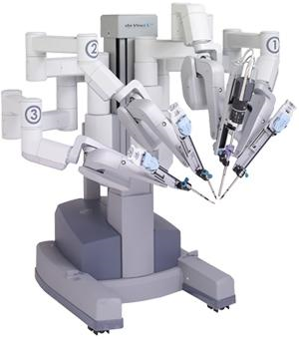
Conclusion
Robotic surgery is becoming more common.
The evidence says that RNs must develop specific knowledge and skills to provide safe and effective robotics-specific care.
When this is achieved, robotic surgery improves patient outcomes.

Slide 26
References
Brenner, Z.R., Salathiel, M., Macey, B.A., Krenzer M. (2011 Jul-Aug). Postoperative care for the robotic surgery bowel resection patient. Gastroenterology nursing, 34(4): 271-5. doi: http://dx.doi.org/10.1097/SGA.0b013e31822486d0.
Melnyk, B. & Fineout-Overholt, E. (2011). Evidence-based practice in nursing & healthcare: a guide to best practice (2nd ed.). Philadelphia, PA: Lippincott Williams & Wilkins.
Murray S. (2009, Winter). Nursing care for patients undergoing transoral robotic surgery. ORL-head and neck nursing, 27(1), 8-12.
Pittman, G. (2013, March). Robotic surgery tied to temporary nerve injuries. Medline Plus. Retrieved from http://www.nlm.nih.gov/medlinesplus/news/fullstory_135431.html.
Ramsey. R. (2012, March). Robotic gynecologic surgery: trends and nurse involvement at a regional hospital. OR nurse journal, 41-44.
Stanton, C. (2010). Establishing a robotic surgery program. AORN Journal, 92(6S), S113-5. doi:10.1016/j.aorn.2010.09.010
Sutton, S., Link, T., Flynn Makic, M.B. (2103, April). A quality improvement project for safe and effective patient positioning during robot-assisted surgery. AORN Journal, 97(4), 448-456.
Thell, C.G. (2011, Sep). Patient Advocacy in Robotic Surgery. Perioperative Nursing Clinics, 6(3), 235-40.
Thomas, C.C. (2011 Sep). Role of the Perioperative Nurse in Robotic Surgery. Perioperative Nursing Clinics, 6(3), 227-34.
Ulmer, B. (2010, May). Best practices for minimally invasive procedures. AORN Journal, 91(5), 558-72. doi: 10.1016/j.aorn.2009.12.028.

